Slide 1

By: Manas Tuwani

Slide 2
STRING FUNCTIONS/METHODS
We are using string functions to perform the string related validations in java.
length(): we are using this function to know the length of the string.
Syntax: variable. Length();

Slide 3
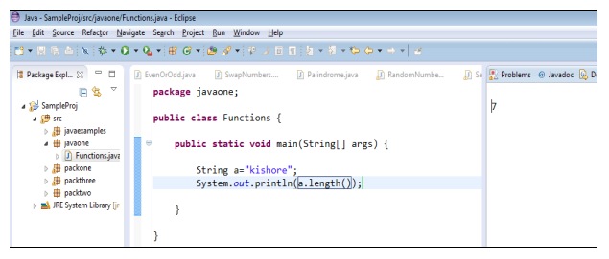

Slide 4
startsWith & endsWith validation
startsWith: To verify whether the string is starting with specific character or not.
Syntax: variable. startsWith (“expected text”)
endsWith: To verify whether the variable is ending with specific character or not.
Syntax: variable. endsWith (“expected text”)

Slide 5
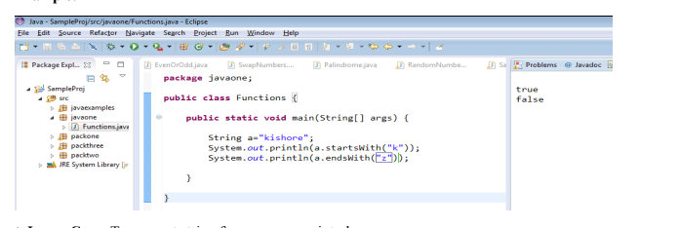

Slide 6
toLowerCase & toUpperCase
toLowerCase: To convert string from uppercase into lower case
Syntax: variable. toLowerCase ();
toUpperCase: To convert string from lowercase into upper case
Syntax: variable. toUpperCase ();

Slide 7
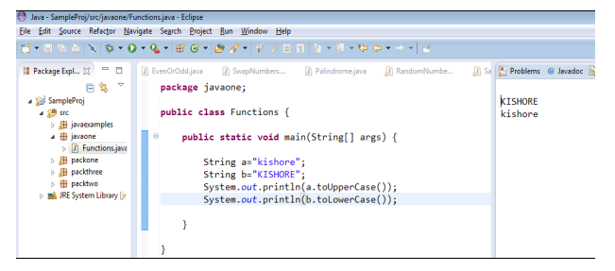

Slide 8
equals & equalsIgnoreCase
equals: To verify whether one string is equal to another string or not.
Syntax: variable. equals (second/another variable)
equalsIgnoreCase: To verify whether variable is same as another variable or not irrespective of
case.
Syntax: variable. equalsIgnoreCase (another variable)

Slide 9
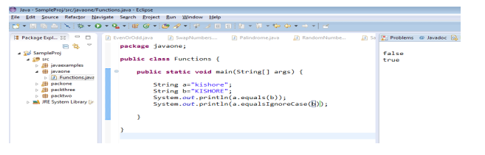

Slide 10
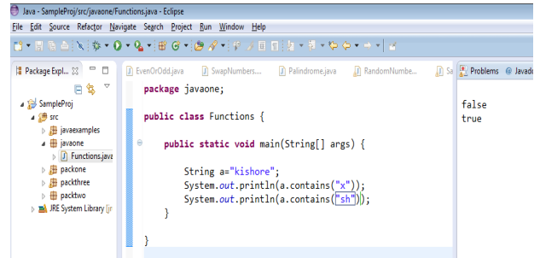
contains: To verify whether the string contains specific value or string or not.
Syntax: variable. contains(“value”);

Slide 11
Practice Problem
String a= ”abcdef”;
String b= “xyz1234”;
String c= “abcxy”;
1. Verify length of the a variable should be greater than length of the c variable and should be less than length of the b variable.
2. A variable should not be same as b variable and c variable
3. C variable should be same as A variable irrespective of the case.
4. A variable should contains cd and should not contains xy
5. Convert B variable into uppercase and verify it should contains “Z” & should not contains “z”

Slide 12
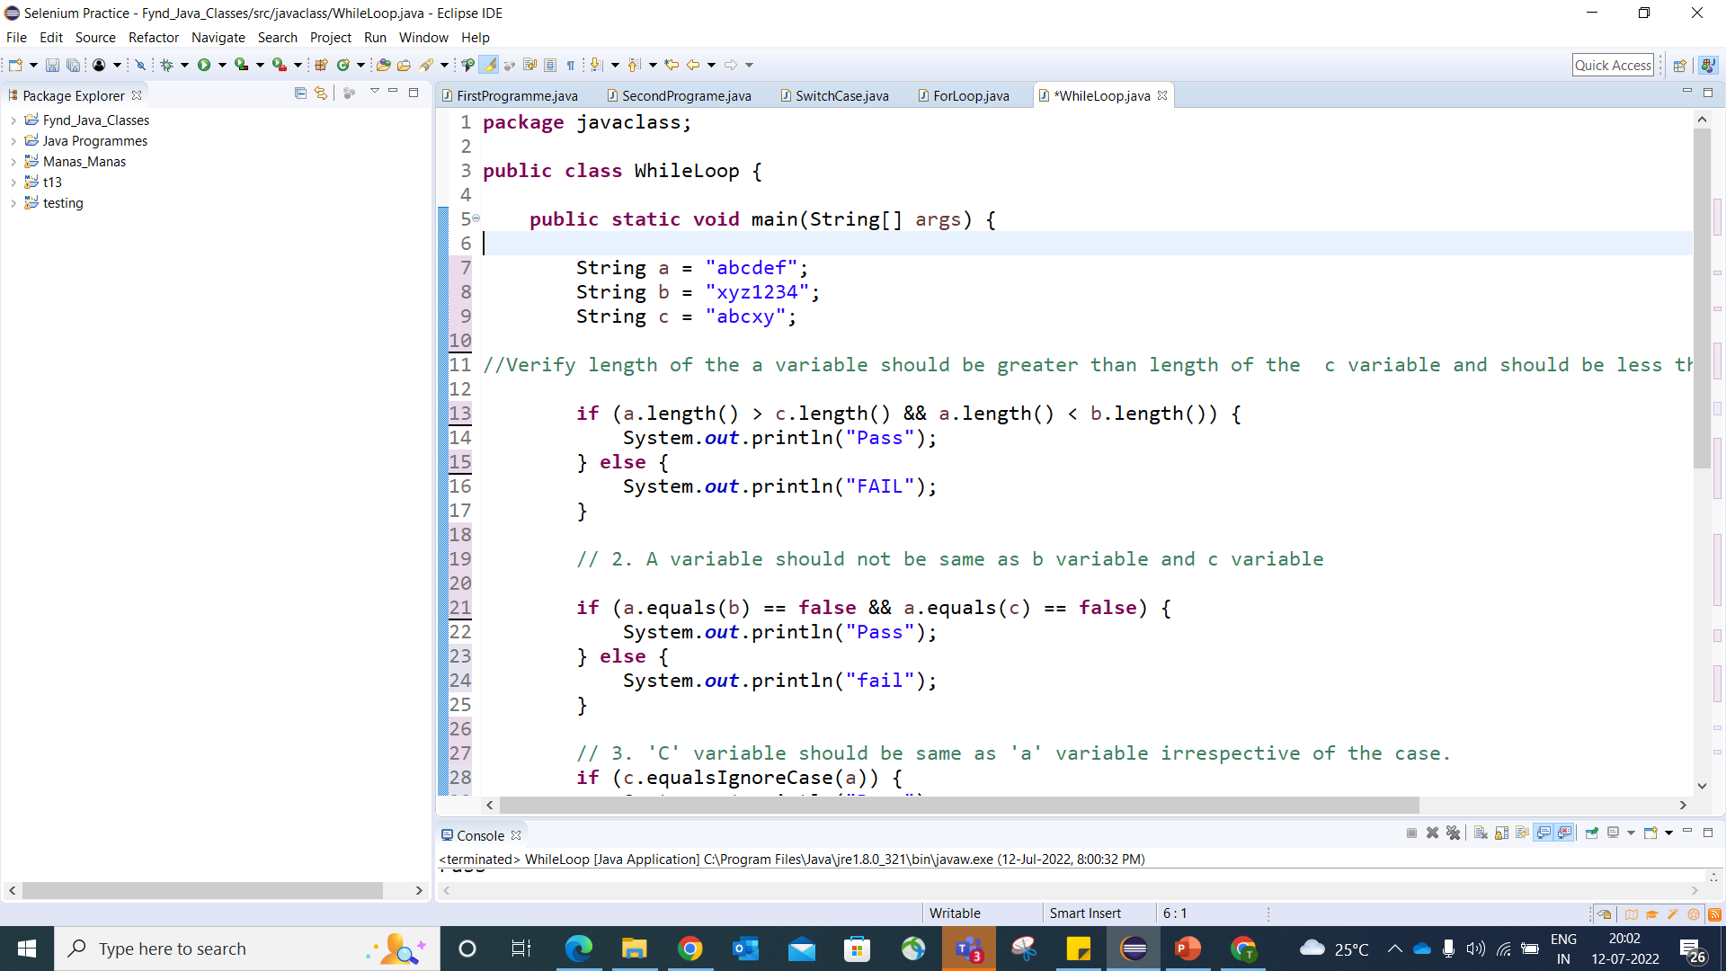

Slide 13
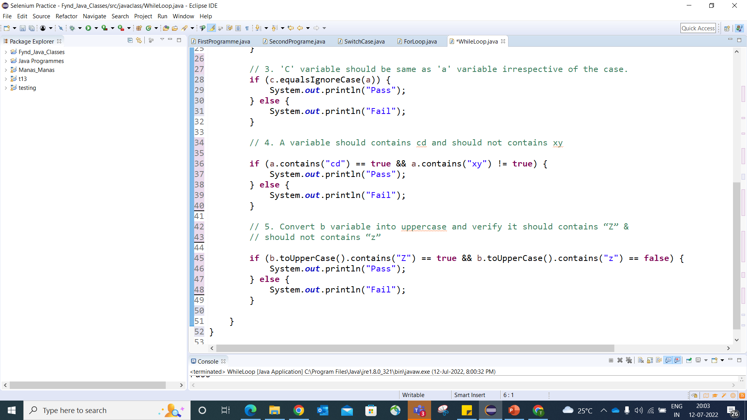

Slide 14
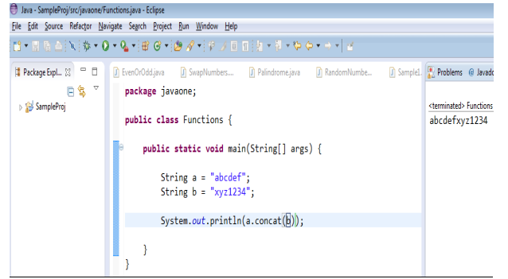
concat: To concatenate one string with another string.
Syntax: variable. concat (“Second String/Var”);

Slide 15
charAt: To verify which character is available in which index of the string
Syntax: variable. charAT (index no);
Note: Usually Length starts with 1 and Index in string starts with 0
indexOf: To verify in which Index which character is available.
Syntax: variable.indexOf (char);

Slide 16
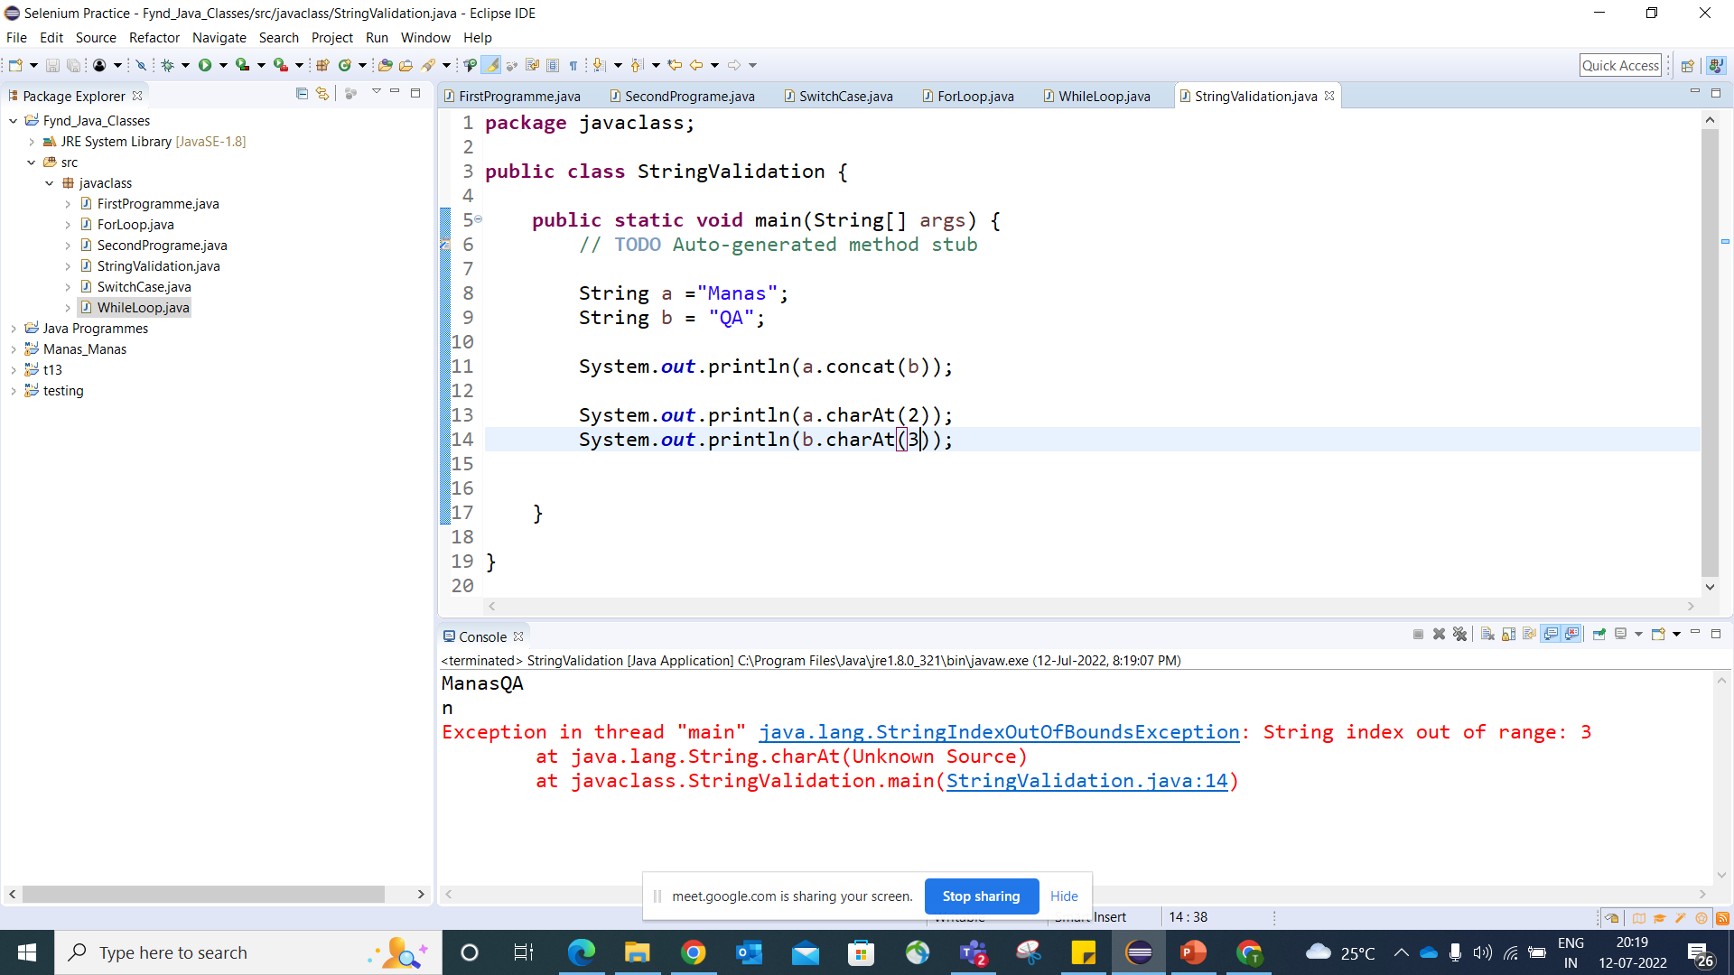
IndexOutOfBond Exception Error

Slide 17
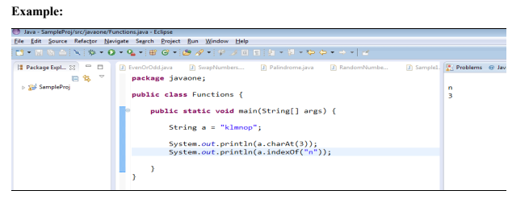

Slide 18
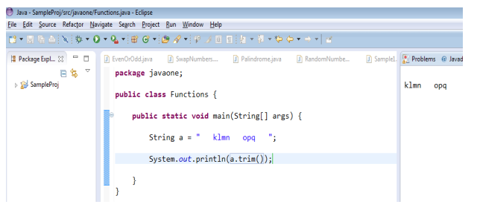
Trim: We are using this function to eliminate starting and ending spaces of the string (first and last spaces)
Syntax: variable. trim ()

Slide 19
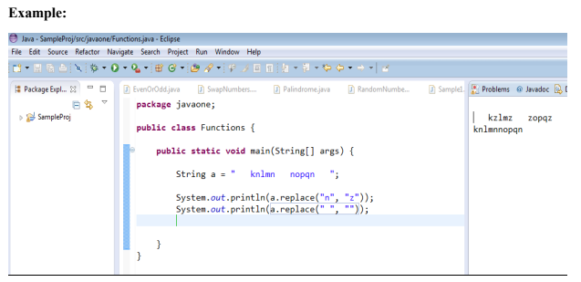
replace: To replace old characters or Strings with new characters or strings in a Var.
Syntax: var. replace (“Old character/String”, “New Character/String”);

Slide 20
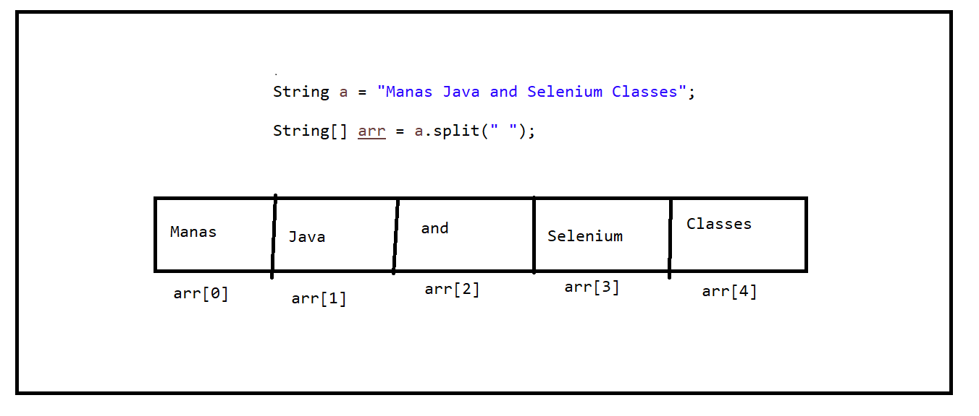
split: To split variable/String into multiple sub strings
Syntax: variable. Split (“separator”);
Note: All split values will be storing into array. That is the reason return type for split function is String [].

Slide 21
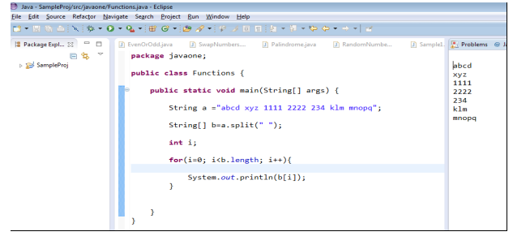
Prepare program to split variable into multiple sub strings and print all strings one by one

Slide 22
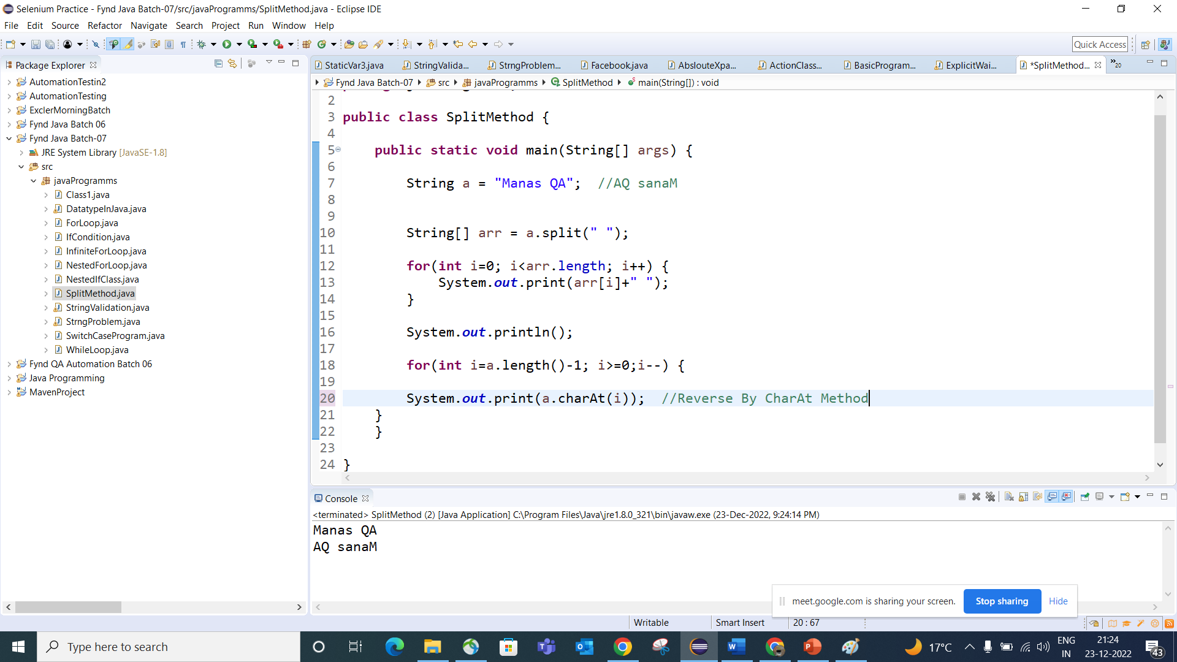

Slide 23
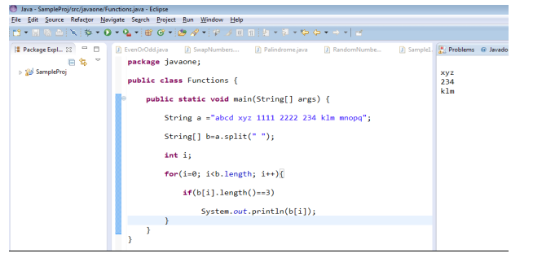
Example: Prepare program to split variable into multiple sub strings and print strings which length is only 3.

Slide 24
Practice Problem:
String a = “abcd”;
String b = "xyz";
String c = "abcd xyz klmn 1234 4567";
Req1: length of the a variable should be greater than length of b and should be less than length of c
Req2: concatenate a and b variables and verify length should be less than c variable length or greater than 5
Req3: a variable should start with “ab” and b variable should not ends with “yz”
Req4: c variable should contains space and should not contains 9
Req5: 7th position in a c variable should be y or z and k should be available in the either 10th or 11th positions.
Req6: split c variable into multiple strings with “ ”(space) and verify length of the array should be 4 or 5
Req7: After split verify first string(Index) of the c variable should be same as a variable and should not be same as 3rd string (Index) of the c variable.

Slide 25
Start your program ….
package javaone;
public class Functions {
public static void main(String[] args) {
String a = "abcd";
String b = "xyz";
String c = "abcd xyz klmn 1234 4567";
}
}

